Slide 1
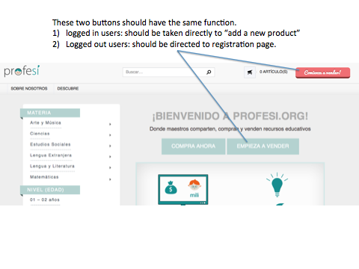
please change text to:
¡EMPIEZA A VENDER!
Notes:
DONE

Slide 2
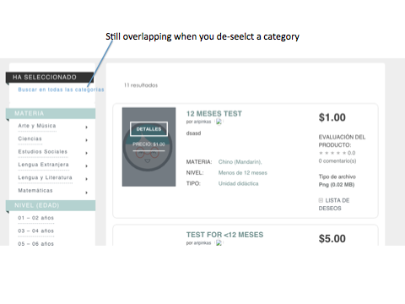
Notes:
Done

Slide 3
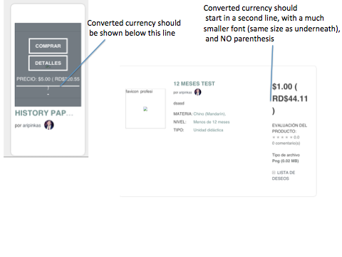
Notes:
done

Slide 4
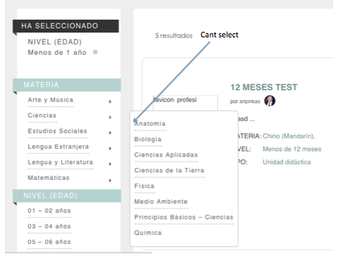
Notes:
Done

Slide 5
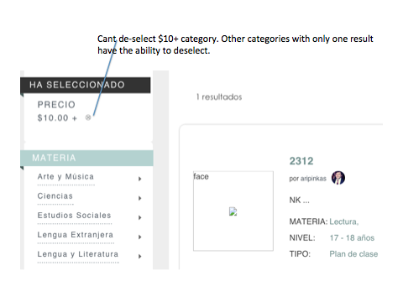

Slide 6
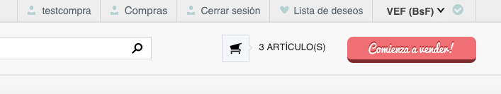
ALSO:
it;d be awesome if u can upload the icons I sent u as well. if not lets do it in batch 2.

